Slide 2
Introduction
Roman Filipoiu
Director of Finance and regulatory affairs
SPP – distribúcia, a.s.
Operating more than 33 thousand km of pipelines
More than 1500 employees
EBITDA ~330 mil. EUR
Member of the board of directors
Stredoslovenská distribučná, a.s.
Operates more than 34 thousand km of power network
More than 1300 employees
EBITDA ~200 mil. EUR
Plynárenská metrológia
roman.filipoiu@spp-distribucia.sk
https://www.linkedin.com/in/roman-filipoiu/

Slide 3
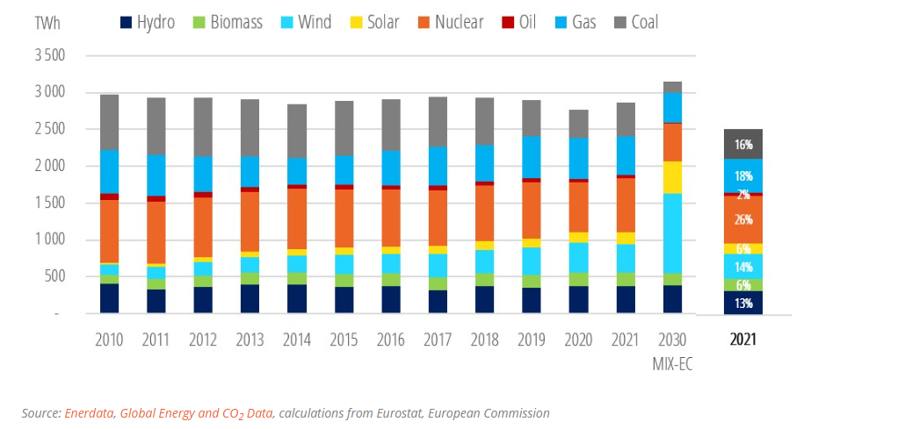
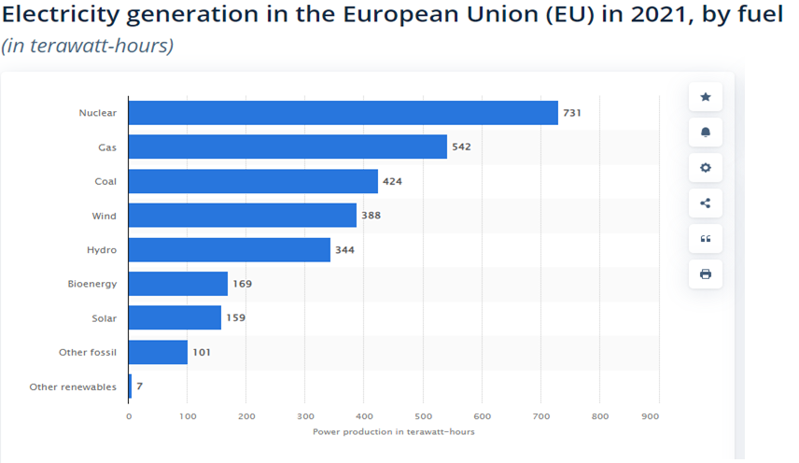
EU electricity production by source
EU is producing stable 3 ths TWh of energy per year
The general policy of EU is to turn from fossil fuels to renewable sources
At the moment, nuclear is considered a clean fuel; natural gas is a transitory fuesl

Slide 4
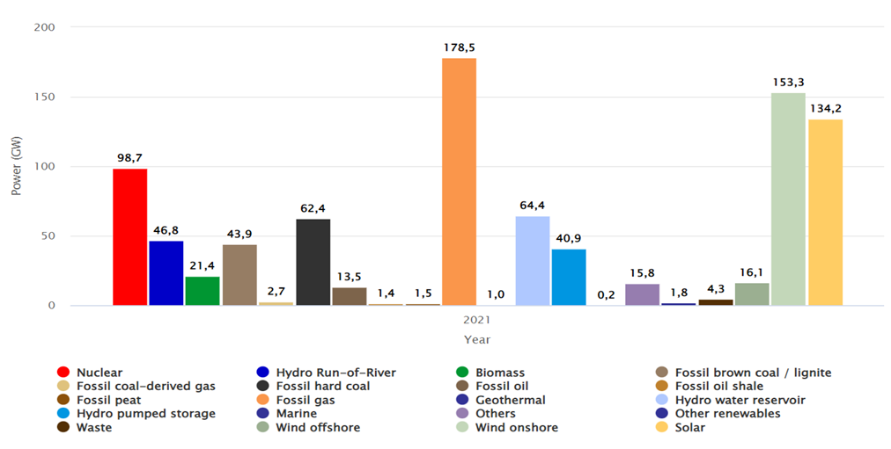
EU electricity production by source
Net installed electricity generation capacity in Europe in 2021
Base-load
Flexibility including predictable renewables
RES

Slide 5
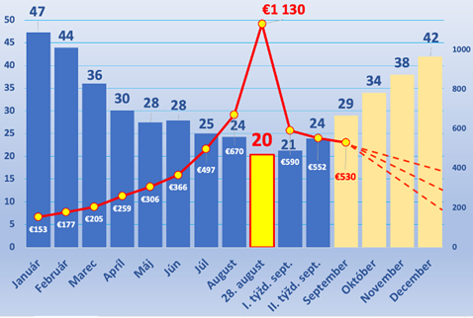
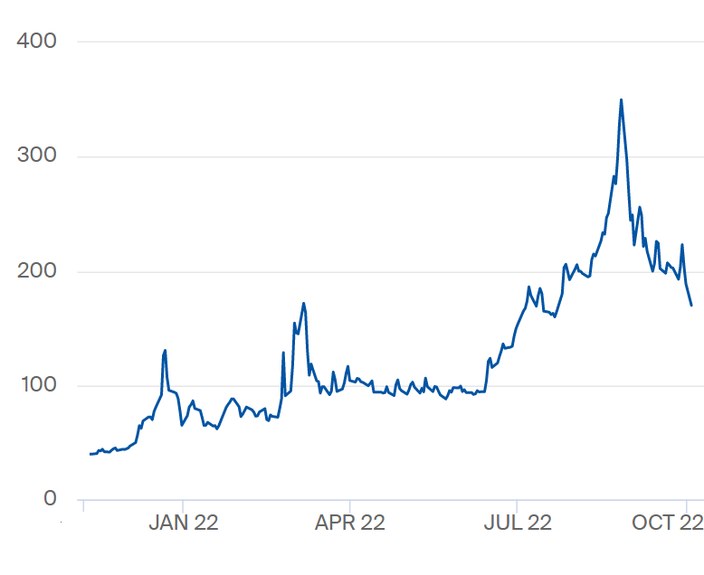
Electricity price peak in summer 2022
French nuclear production vs electricity price
Natural gas contracts (TTF – EUR/MWh)
France usually exports the excess electricity it produces. But this year it has become a net importer, meaning that neighbouring countries are burning additional gas to generate electricity for France just as Europe is otherwise trying to conserve supplies for the winter.

Slide 6
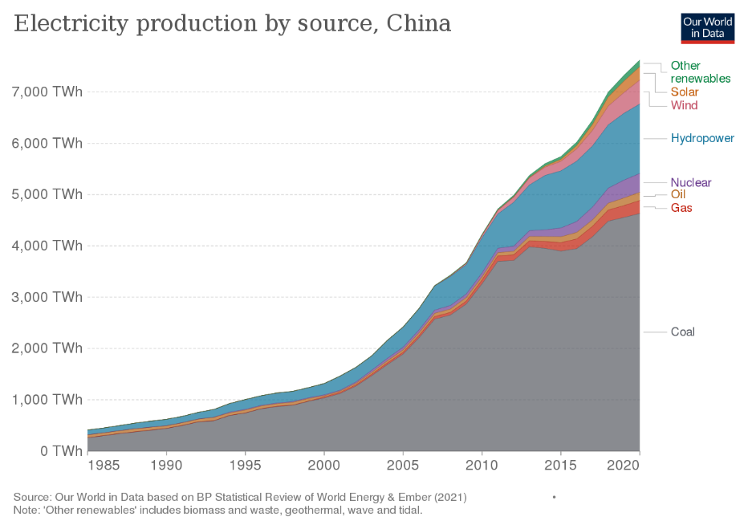
European gas balance (YTD = 1/1/2022 – 31/8/2022
European consumption 2022 could be around 534 bcm
year | Consumption | Indig. Prod. | Norway | N. Africa | Other (AZ, IR) | LNG | Russia | Storage to Consumption
2015 | 529 | 155 | 110 | 31 | 14 | 51 | 169 | (0)
2016 | 554 | 150 | 109 | 40 | 14 | 51 | 182 | 6
2017 | 581 | 148 | 117 | 39 | 16 | 61 | 204 | (4)
2018 | 570 | 137 | 116 | 39 | 16 | 65 | 202 | (5)
2019 | 576 | 130 | 111 | 28 | 18 | 115 | 202 | (27)
2020 | 569 | 119 | 112 | 26 | 17 | 110 | 175 | 9
2021 | 604 | 109 | 117 | 39 | 27 | 101 | 178 | 33
2022* | 346 | 71 | 80 | 23 | 22 | 108 | 70 | (28)
* 2022 – YTD as of 31/8/2022
EU storage fullness at 89,3% (3.10.2022)
Other countries can well absorb the portion of natural gas saved by Europe

Slide 7
Russian flows influencing European gas prices
GPE current Revenues
GPE avg. daily Revenues
2017-2021

Slide 8
Projection of Natural gas consumption in Europe without Russian Gas
5y avg. Consumption
Reduced Consumption
New eff. lique. coming online 2022-23 = +16 bcm
New eff. lique. coming online
2024 = +36 bcm
2025 = +44 bcm
2026 = + 80 bcm
Cumm. Eff. Lique. Cap. up to 2026 = 176 bcm
2022-24 – full replacement of RU gas is not possible without demand destruction;
2025-2026 – provided the construction of suitable infrastructure, it is possible to cover the natural gas reduced need even without Russian supplies. However, a sufficient LNG supply on global market and supply swaps of Norwegian / N. African gas between European countries is a prerequisite.
In the near future, the Russian gas supply disruption does not appear to be a possible alternative for Europe due to LNG limitations on:
liquefaction production, shipment capacities, infrastructure capacities
8

